Slide 1
Coptic Lesson 9
Rules for Coptic Letters with Multiple Pronunciations

Slide 2
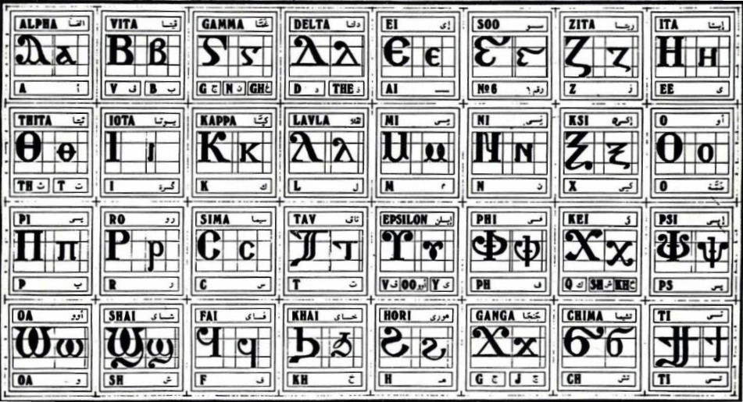
Coptic Alphabets

Slide 3
Alphabet Review
^ x u f ou
L : P V ' [
S q J G H
D Y R <
A B E Z I K M N O C T W }

Slide 4
Alphabet Questions
;
Th, t
Thita
s
sh
Shai
}
ti
Ti
p
p
Pi
c
s
Sima
M
m
Mi
x
x
Ksi

Slide 5
Rule for the Vita B
v
(before a vowel, except in names)
B b =
b
(otherwise)
Examples:
hwb
qybc
Iakwb
baki
nyb
kwbab
tebc
nobi
lobs
,eroubim
niben
noub
abwk
`mbon

Slide 6
Rule for the Ghamma G
e-family:
e> y> i> u
g
(before e-family)
G =
gh
(otherwise)
n
(before g> x> k> ,)
Examples:
genoc
agora
aggeloc
agioc
`gravy
calpigx
gumnacia

Slide 7
Rule for the Delta D
d
(in names)
D d =
z
(otherwise)
Examples:
doxa
dikeoc
Dauid
dwron
Daniyl
demwn

Slide 8
Rule for the Theeta :
th
: ; =
t
(after t> s> c)
Examples:
`c;oi (smell)
;wm (lock)
`;myi (righteous)
`s;eh (hot)
;ai (this)
`s;orter (disturbed)

Slide 9
Rule for the Iota i:
e
(if 1st letter in a word)
ee
I i =
(between consonants)
y
(next to a vowel)
Examples:
isi
rwmi
iom
Icrayl
niben
Ic,uroc
nai
`agioc
`<rictoc
`ilewc
Mari`a

Slide 10
Rule for the Epsilon U
V
(after a>e)
U u =
oo
(after o - ou)
ee
(after constant, or with Jinkim`)
Examples:
mau
soury
humnoc
ouro
Eu`a
dumiany
`cnau

Slide 11
Rule for the Kei <:
k
(in a Coptic Word)
< , =
sh
(Gk, before the e-family)
e-family:
e> y> i> u
kh
(Gk, otherwise)
Examples:
,ymi
,aric
,ere
`,rwm
Ar,y
Mona,oc
,w
Lu,nia
Pi,iwn
,wra
Ic,uroc

Slide 12
Rule for the Ganga J
g
E-family:
e> y> i> u
J j =
j
(before the e-family)
Examples:
jwm
caji
jwri
jij
ajp
jaji
jyk

Slide 13
Announcement

Slide 14

Oujai qen `P[oic

